Slide 1

Clustering
Finding clumps in data
Yordan Darakchiev
Technical Trainer
iordan93@gmail.com

Slide 2
sli.do #MachineLearning

Slide 3
Table of Contents
Unsupervised learning – problem description
Clustering – problem description, approaches
k-means clustering
kMeans++
Hierarchical clustering
DBSCAN
Clustering and classification
Evaluating clustering / classification performance

Slide 4
Clustering Analysis
Finding clumps in data

Slide 5
Clustering Analysis
Unsupervised learning
Discover hidden structures in data where we don't know the right answer upfront
Clustering
Find a natural grouping in data such that items in the same cluster are more similar to each other than those from different clusters
Some applications
Medicine: classify different types of tissues
Marketing: group similar products
Image segmentation, object recognition
Social network analysis
Crime analysis: "hot" spatial areas; similar crimes

Slide 6
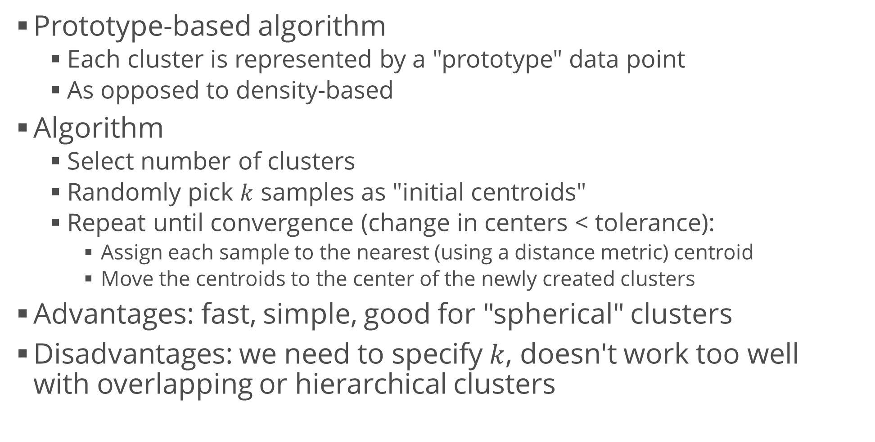
k-Means Clustering
Prototype-based algorithm
Each cluster is represented by a "prototype" data point
As opposed to density-based
Algorithm
Select number of clusters
Randomly pick $k$ samples as "initial centroids"
Repeat until convergence (change in centers < tolerance):
Assign each sample to the nearest (using a distance metric) centroid
Move the centroids to the center of the newly created clusters
Advantages: fast, simple, good for "spherical" clusters
Disadvantages: we need to specify $k$, doesn't work too well with overlapping or hierarchical clusters

Slide 7
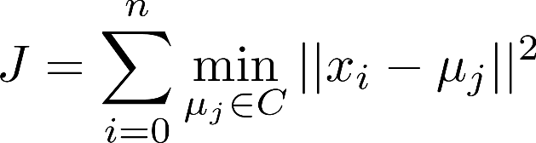
k-Means Clustering (2)
Objective function
Minimize the cluster inertia
Within-cluster sum of squared errors (Euclidean distances)
Generating clusters
We can use scikit-learn to generate "blobs" (clusters)
Other options – "circles", "moons", etc.
from sklearn.datasets import make_blobs
attributes, clusters = make_blobs(cluster_std = 1)
plt.scatter(attributes[:, 0], attributes[:, 1], c = clusters)
from sklearn.datasets import make_blobs, make_circles,
make_regression, make_s_curve, make_swiss_roll
# The last two are 3D – you can either plot them # or see their projections using the x, y and z axes

Slide 8
Example: k-Means Clustering
Generate several datasets
Blobs, circles, moons
Apply k-means clustering to each dataset
Display the original clusters and the clustering results
How do they differ? Can you explain why?
from sklearn.cluster import KMeans
attributes, clusters = make_blobs()
k_means = KMeans(3, init = "random")
assigned = k_means.fit_predict(attributes)
# Original, generated clusters
plt.scatter(attributes[:, 0], attributes[:, 1], c = clusters)
plt.show()
# Assigned clusters
plt.scatter(attributes[:, 0], attributes[:, 1], c = assigned)
plt.show()

Slide 9
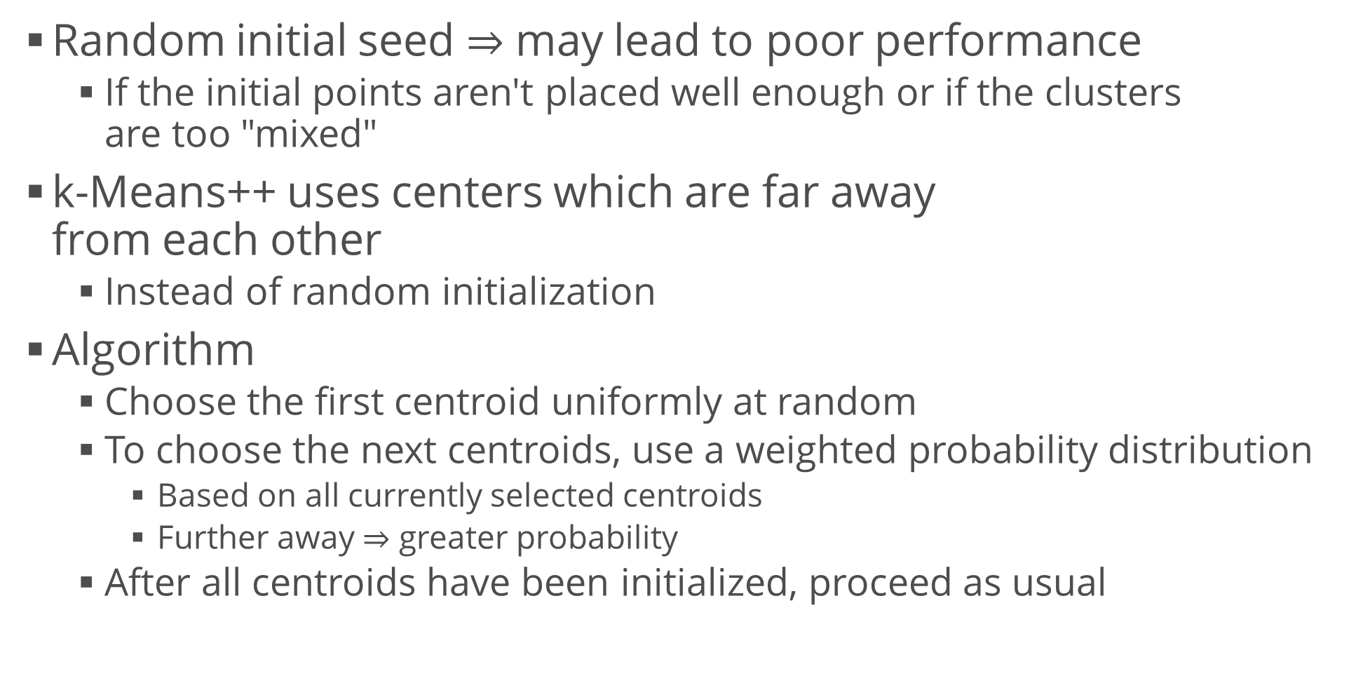
k-Means++
Random initial seed $⇒$ may lead to poor performance
If the initial points aren't placed well enough or if the clusters are too "mixed"
k-Means++ uses centers which are far away from each other
Instead of random initialization
Algorithm
Choose the first centroid uniformly at random
To choose the next centroids, use a weighted probability distribution
Based on all currently selected centroids
Further away $⇒$ greater probability
After all centroids have been initialized, proceed as usual

Slide 10
Example: k-Means++
Generate several datasets
Blobs, circles, moons
Apply k-Means++
Compare the performance of k-means++ versus k-means on blobs that are "close" to each other
Generate blobs with a higher standard deviation
Plot the centroids
* Count the misclassified points for the two algorithms
attributes, clusters = make_blobs()
k_means = KMeans(3, init = "k-means++")
assigned = k_means.fit_predict(attributes)

Slide 11
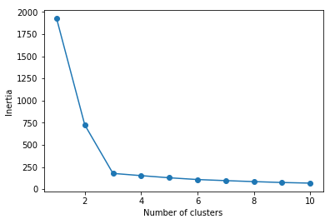

Finding an Optimal Number of Clusters
Elbow method – graphical
Inertia is a measure of clustering quality
Like grid search, initialize KMeans with a range of $k$ values
Fit and calculate the inertia (given by default in scikit-learn)
Plot inertia vs. number of clusters
Find the "elbow point" of the plot – optimal
Inertia always decreases but some models overfit the data
inertias = []
for i in range(1, 11):
km = KMeans(n_clusters = i)
km.fit(attributes)
inertias.append(km.inertia_)
plt.plot(range(1,11), inertias, marker = "o")
plt.xlabel("Number of clusters")
plt.ylabel("Inertia")
plt.show()

Slide 12
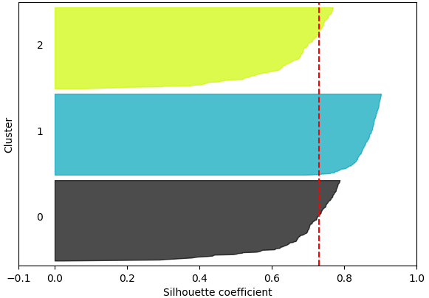
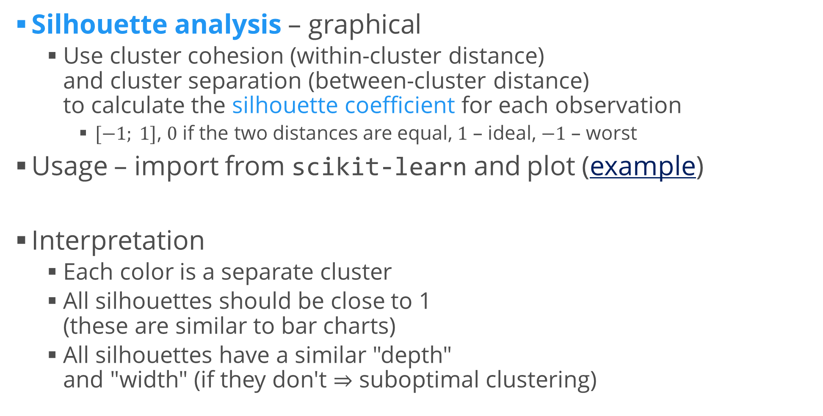
Evaluating Clustering Quality
Silhouette analysis – graphical
Use cluster cohesion (within-cluster distance) and cluster separation (between-cluster distance) to calculate the silhouette coefficient for each observation
$[−1; 1]$, $0$ if the two distances are equal, $1$ – ideal, $−1$ – worst
Usage – import from scikit-learn and plot (example)
Interpretation
Each color is a separate cluster
All silhouettes should be close to 1 (these are similar to bar charts)
All silhouettes have a similar "depth" and "width" (if they don't $⇒$ suboptimal clustering)
from sklearn.metrics import silhouette_samples

Slide 13
Hierarchical Clustering
Another prototype-based clustering
Advantage – allows us to plot dendrograms
Visualizations of binary hierarchical clustering
Allow us to interpret the results
Algorithm
Compute the distance matrix (distances between any two points)
Start with each point at its own cluster
Repeat until only one cluster is left:
Merge the two closest clusters and update the distances
Update the distance matrix
In scikit-learn, linkage describes the selected distance metric
from sklearn.cluster import AgglomerativeClustering
aggl = AgglomerativeClustering(n_clusters = 3, linkage = "complete")

Slide 14
Example: Hierarchical Clustering
Perform hierarchical (agglomerative) clustering on several datasets and visualize the results
Blobs, moons, nested circles
Try different linkage strategies
Plot a dendrogram
linkage() calculates a distance matrix
dendrogram() creates the plot (x-axis: ID, y-axis: distance)
from scipy.cluster.hierarchy import linkage, dendrogram
row_clusters = linkage(attributes, method = "complete", metric = "euclidean")
dendrogram(row_clusters, labels = clusters)
plt.show()
# Show only the last 10 merged clusters
dendrogram(row_clusters, labels = clusters, truncate_mode = "lastp", p = 10)

Slide 15
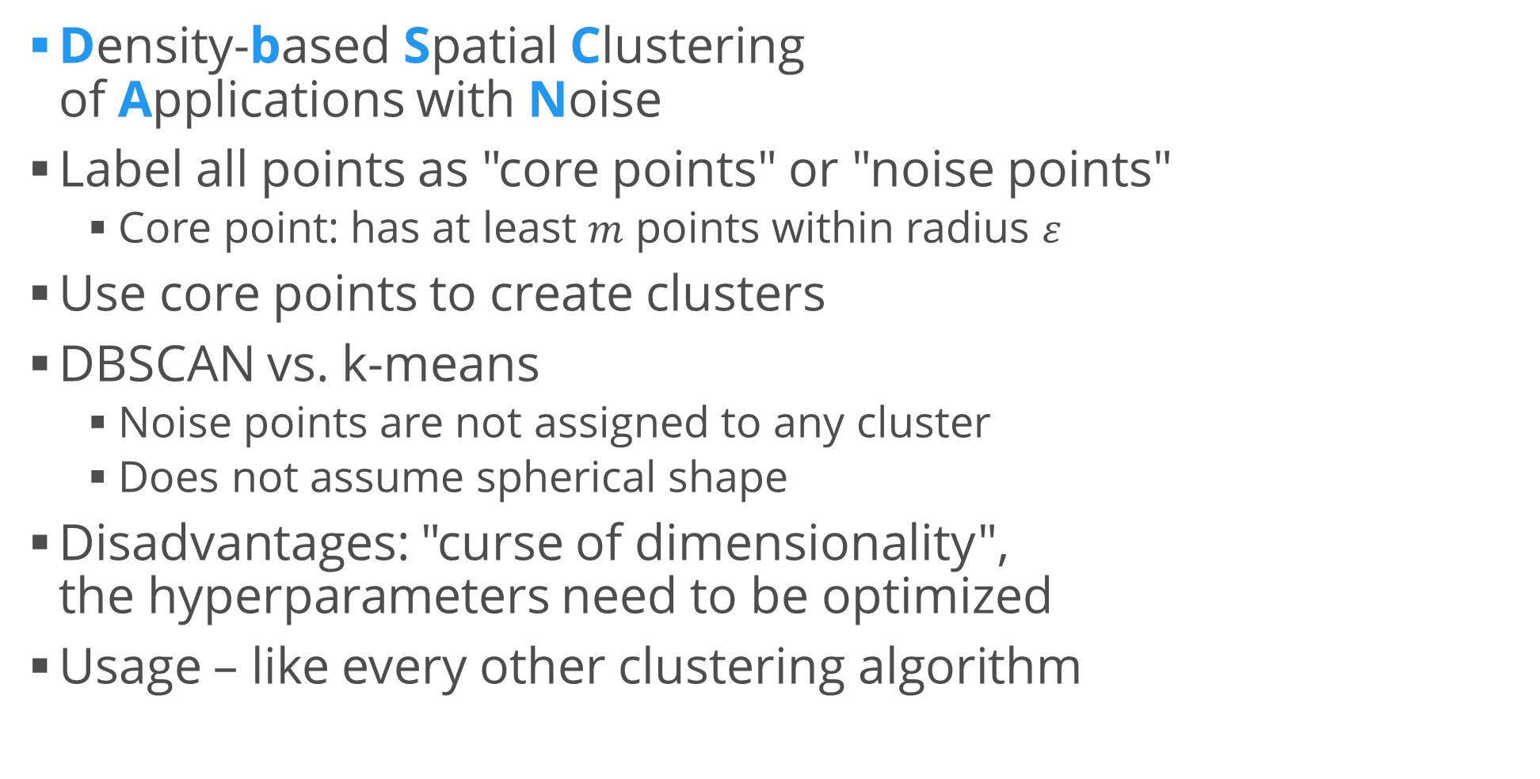
DBSCAN
Density-based Spatial Clustering of Applications with Noise
Label all points as "core points" or "noise points"
Core point: has at least $m$ points within radius $ε$
Use core points to create clusters
DBSCAN vs. k-means
Noise points are not assigned to any cluster
Does not assume spherical shape
Disadvantages: "curse of dimensionality", the hyperparameters need to be optimized
Usage – like every other clustering algorithm
from sklearn.cluster import DBSCAN
db = DBSCAN(eps = 0.2, min_samples = 5, metric = "euclidean")

Slide 16
Example: DBSCAN
Compare the performance of DBSCAN to the other clustering algorithms
Use the previous datasets and results
Which algorithm performs best on which dataset?
Clustering comparison in scikit-learn
Conclusion
It's not always obvious which algorithm performs best on a dataset
Especially if data comes in many dimensions
A successful clustering depends on the algorithm and its hyperparameters
We need to choose an appropriate distance metric
We need some domain knowledge

Slide 17
Clustering and Classification
Sometimes, classification tasks can be reduced to clustering tasks
Most trivially: just ignore the labels
Assumption: The data is easily (e.g. linearly) separable
The opposite is also true: we may be able to find a function that assigns a label to each data point
This is exactly what clustering does
We can apply and compare both classification and clustering algorithms, metrics and tools to the same task
Even in ensembles
Example

Slide 18
Summary
Unsupervised learning – problem description
Clustering – problem description, approaches
k-means clustering
kMeans++
Hierarchical clustering
DBSCAN
Clustering and classification
Evaluating clustering / classification performance

